Slide 1




BISCONNI PRESENTATION
Presented by
Hamza Mirza & Immar Sultan

Slide 2


Slide 3
Company Introduction:
Bisconni started its journey in 2002 with the philosophy of producing biscuits which meet international standards of quality and food safety.

Slide 4
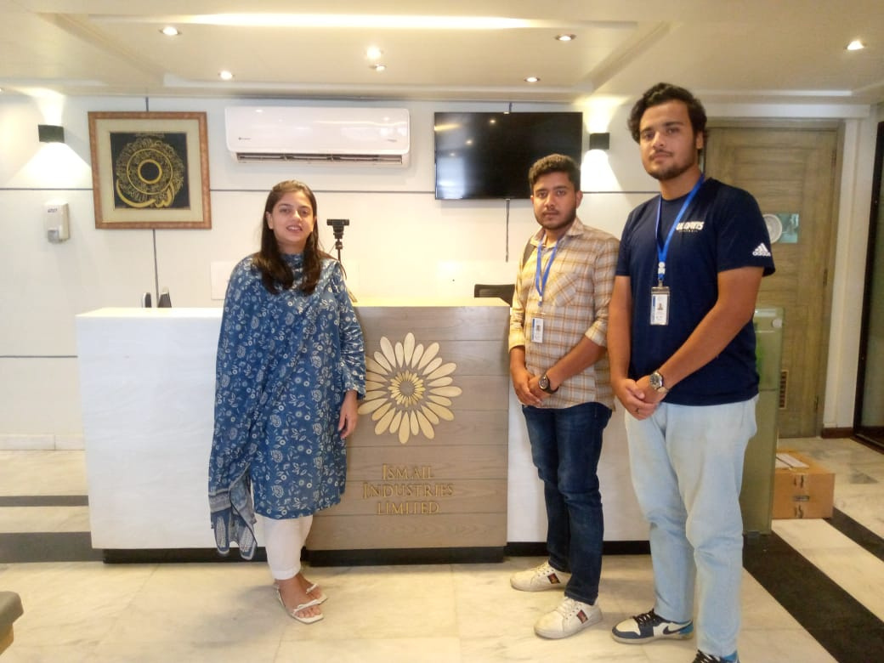

Slide 5
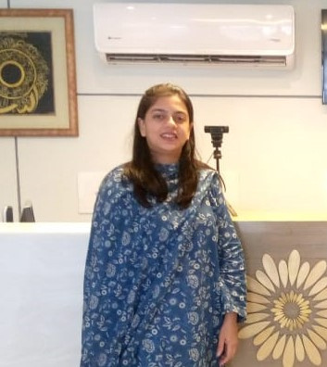
Nigah-e-Ahsain
The Senior Brand Manager, Nigah-e-Ahsain, who has been with the company for 2.5 years.

Slide 6
Overview of Company Logo:
Colors: Red and Yellow
Significance:
Red: Reflects premium quality
Yellow: Represents the core values

Slide 7
Customer Feedback:
Methods of Collecting Feedback:
Surveys
Social media interactions
Direct customer reviews
General Feedback:
Positive reception
High appreciation for quality and variety

Slide 8
Marketing Channels:
Traditional Media:
Television advertisements
Print media
Billboards
Digital Media:
Social media platforms
Key Platform: Instagram for PR and engagement

Slide 9
Sales Distribution:
Online Market:
40% of total sales
E-commerce platforms and company website
Offline Market:
60% of total sales
Retail stores and supermarkets

Slide 10
Packaging:
Focus:
Attractive and functional design
Ensures product safety and freshness
Plays a significant role in marketing

Slide 11
Corporate Social Responsibility (CSR):
Community Engagement:
Educational programs
Health initiatives
Food donations
Employee Welfare:
Safe and healthy working environment

Slide 12
Economic Condition:
Current State:
Stable economic condition
Steady growth in revenue and market share
Sales Strategy:
Balanced approach between online and offline markets

Slide 13
Conclusion
Summary:
Bisconni thrives in a competitive market under the guidance of professionals like Nigah-e-Ahsain.
Emphasis on quality, sustainability, and customer satisfaction.
Strategic marketing and social responsibility efforts bolster brand reputation and market presence.

Slide 14


Thank You

